Slide 1


Machine Learning Workshop
Paulo Izquierdo Romero, Thilanka Ranaweera,
Kenia Segura Abá, Shin-Han Shiu, Jingyao Tang
Michigan State University
GLBRC ASM – Tuesday, 5/14
Notes:
Image credit:
https://www.pinterest.com/pin/292945150756287202/
https://www.pinterest.com/pin/549509592004746347/

Slide 2
Logistics
Resource for today’s workshop:
Instruction
The pre-workshop Jupyter notebook
The workshop Jupyter notebook and dataset
This PowerPoint
https://github.com/ShiuLab/ML_workshop
Code of conduct - behaviors that will not be tolerated:
Any form of discrimination, e.g., based on gender, race, sexual orientation, age, or others.
Any form of harassment, e.g., sexual, verbal, bullying or others
Offensive language or behavior
Deliberate intimidation, sustained disruption.

Slide 3
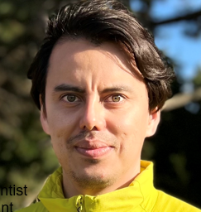


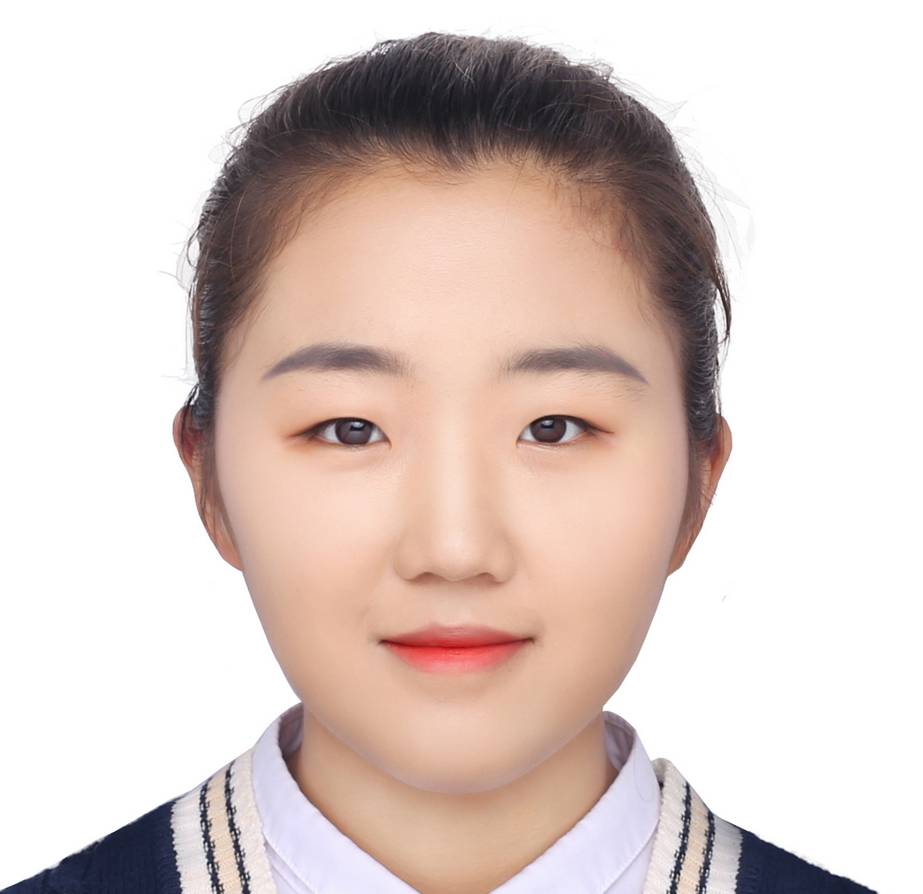
Who we are
Paulo Izquierdo Romero
Postdoctoral scientist
MSU Plant Biol
Kenia Segura Abá
Graduate student
MSU Genetic & Genome Sci
Thilanka Ranaweera
Graduate student
MSU Plant Biol
Jingyao Tang
Graduate student
MSU Comp Math Sci Engr

Slide 4
Goals of this workshop
At the end of this, you should be able to:
Define ML and basic ML terminology
Follow the example in this workshop to solve your own problems
Describe how a model can be evaluated with a performance measure
Explain to others what the major limitations of ML are

Slide 5
Workshop outline
Components | Duration | Details
Introduction | 10 min | What is machine learning (ML) and why?
Part A review | 10 min | ML workflow revisited
Step 1 | 10 min | Define ML problem
Step 2 | 15 min | Conduct exploratory data analysis
Step 3 | 10 min | Split training/testing data
Break | 5 min
Step 4 | 20 min | Engineer features
Step 5 | 20 min | Select model
Step 6 | 20 min | Repeat 2~5 to get the optimal model
Break | 5 min
Step 7 | 20 min | Evaluate model
Step 8 | 20 min | Interpret model
Wrap-up | 10 min | What we have done today

Slide 6



Intro: why is ML & why
Knowledge
Consider how we learn
A task, goal, question, or problem
Yes!
Input: Experiences to learn from
Output:
A model making predictions
Answers
Good
enough?
No!

Slide 7

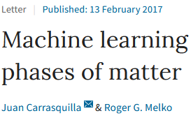
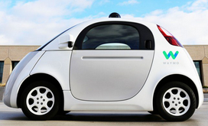
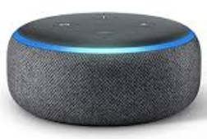
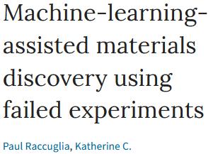
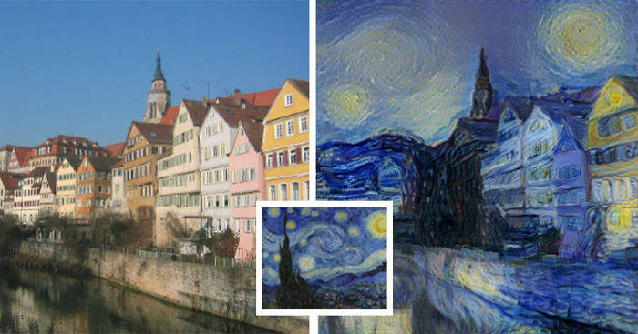
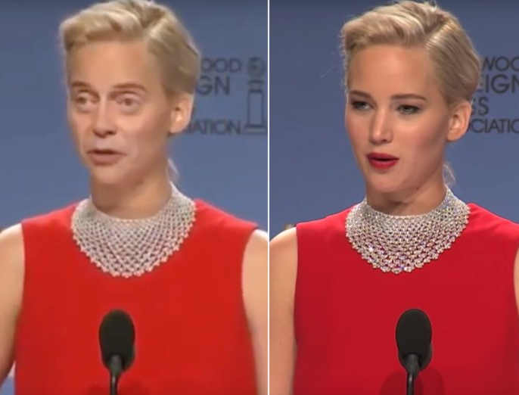
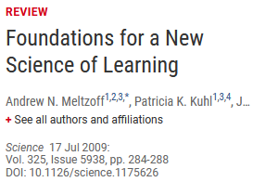

Intro: why is ML & why
ML publications in PubMed as of 3/9/22
As a person
As a scientist
As a biologist
As a plant biologist
Machine learning
Others
(27,249)
Human
(38,487)
Plant (1,848)
Image credits: in notes
Notes:
Image credits:
https://cdn.technologyreview.com/i/images/waymovehicle1.jpg?sw=959&cx=0&cy=466&cw=3000&ch=1687
https://compostables.org/wp-content/uploads/2018/09/All-new-Echo-Dot-3rd-Gen-Smart-speaker-with-Alexa-Sandstone-0.jpg
https://amp.businessinsider.com/images/5c6d85ca2628986f7f3a5d02-750-563.jpg
https://static.boredpanda.com/blog/wp-content/uploads/2015/08/computer-deep-learning-algorithm-painting-masters-fb__700.jpg
https://media.salon.com/2019/01/facial-recognition2.jpg
https://www.greenmangaming.com/newsroom/wp-content/uploads/2019/07/GooglrDeepMind.jpg

Slide 8
Intro: why is ML & why
Address questions
previously not
answerable or
conceived
Growing data: What can we learn and how?
Molecular data
Evolutionary/
ecological data
Assess quantitatively
how much we know
Genomes
Metabolomes
Physiological
measurements
Models
integrating
heterogeneous
info
Provide testable
hypothesis
Transcriptomes
Morphological
measurements
Proteomes
Methylome
Identify potential
issues in the data
Environmental
Microbiomes
ML
algorithms
Interactomes
And more…
Transfer models
to data-poor
areas/species
And more…

Slide 9
Part A review
Global & local
interpre-tation
ML workflow
Step 8:
Interpret
model
Step 4:
Engineer
features
Step 5:
Select
models
Step 1:
What is the question?
Step 3:
Split train/test
Answers
Good
enough?
Training
data
Training
Data
(engineered)
ML
model
Model
Performance
training
instances
80%
Step 2:
How does the data look like?
Data
Step 6: Repeat 2-5
No!
Testing
data
Model
Performance
testing
data
Yes!
20%
Step 9:
deploy
model
New data
Predictions
Step 7:
Evaluate
best performing
model

Slide 10
Step 1: Define ML problem
QUESTION:
Discuss with your neighbors
What is one research question you work on that may benefit from the use of machine learning?

Slide 11
Step 1: Define ML problem
Given:
Known genes in general metabolism (GM) or specialized metabolism (SM)
Various features of genes
E.g., expression levels, functional category they belong to
How can we use them to:
Distinguish genes involved in GM from those involved in SM?
QUESTION:
Discuss with your neighbors, what gene features should we use to best distinguish GM and SM genes?

Slide 12
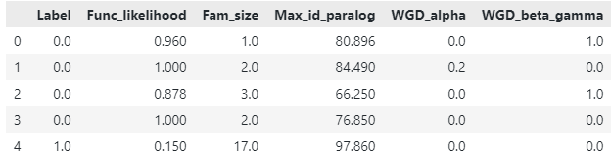
Step 2: Exploratory data analysis (EDA)
How does our data look like?
Labels (y)
Features (X)
Instances

Slide 13
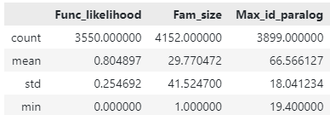
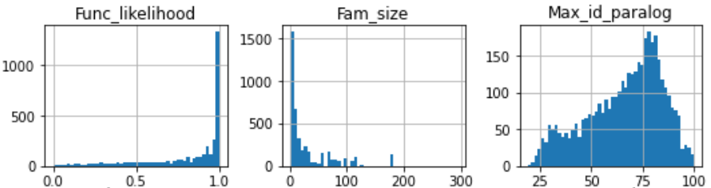
Step 2: Exploratory data analysis (EDA)
Univariate
2.1 Non-graphical
2.2 Graphical: e.g., histogram
QUESTION:
What problems did you see?
3. Distributions
not normal
1. Unwanted
instances
4. Missing values
2. Varied data
ranges
5. Imbalanced
numbers of labels
Notes:
Unwanted labels
Data range
Non-normal distributions
Different types of data

Slide 14
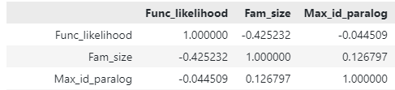
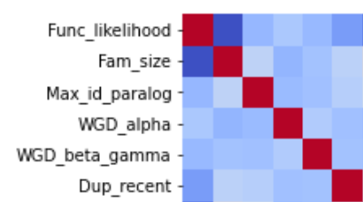
Step 2: Exploratory data analysis (EDA)
Multivariate
2.3 Non-graphical: e.g., correlations
2.4 Graphical: e.g., heatmap
QUESTION:
What problems did you see?
6. Colinear
variables

Slide 15
Step 3: Split training and testing data
Q: Why would there be
unwanted instances?
3.1 Deal with unwanted instances
3.2 Split data into training and testing sets
Train
Output:
ML
model
Training
data
80%
Input:
all instances
all features
Testing
data
Apply
Model
Perform-
ance
20%

Slide 16
Step 4: Feature engineering
Process features and identify features relevant to the underlying tasks
Feature
engineering
Training
data
Output:
ML
model
80%
Input:
all instances
all features
Train
Testing
data
Apply
Model
Perform-
ance
20%

Slide 17
Step 4: Feature engineering
4.1 Deal with missing data
Drop ALL rows and/or columns
with any missing data
Assume missing values are likely to be close to e.g., the mean value
Assume the missing value of an instance is similar to its neighbors’ value
In our example,
this will throw out ~40% of the data. Not good.
This can be done with SimpleImputer
This can be done with KNNImputer
K-Nearest Neighbor
Notes:
How many problem(s) can you find in this dataset??
1, 3, 5, 7, 9
More information:
https://elitedatascience.com/data-cleaning
https://towardsdatascience.com/the-art-of-cleaning-your-data-b713dbd49726

Slide 18
Step 4: Feature engineering
4.2 Data imbalance
In train_keep_imp
Class 0: 1529 (85%)
Class 1: 272 (15%)
Strategy 1:
Down-sample
Class 0: 272 (50%)
Class 1: 272 (50%)
Strategy 2:
Up-sample
Class 0: 1529 (50%)
Class 1: 1529 (50%)
Strategy 3:
Mixed
Class 0: 611 (50%)
Class 1: 611 (50%)
Model will be biased toward one class.
Many valuable instances are thrown out, lead to underfitting.
Existing data is reused, lead to overfitting.
Tried to mitigate both issues with the middle ground. Not guaranteed to work.
Notes:
How many problem(s) can you find in this dataset??
1, 3, 5, 7, 9
More information:
https://elitedatascience.com/data-cleaning
https://towardsdatascience.com/the-art-of-cleaning-your-data-b713dbd49726

Slide 19
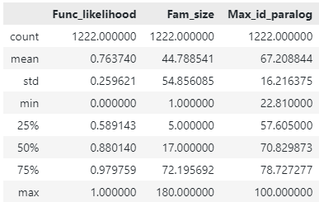
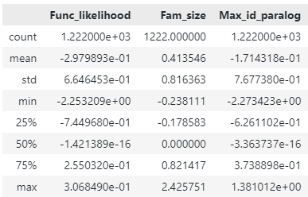
Step 4: Feature engineering
4.3 Data scaling
After scaling / normalization / standardization
Notes:
How many problem(s) can you find in this dataset??
1, 3, 5, 7, 9
More information:
https://elitedatascience.com/data-cleaning
https://towardsdatascience.com/the-art-of-cleaning-your-data-b713dbd49726

Slide 20
Step 5: Model/algorithm selection
Choose among candidate models to find the best one
Model
selection
Training
data
Output:
ML
model
80%
Input:
all instances
all features
Training
Testing
data
Application
Model
Perform-
ance
20%

Slide 21

Why would there be many models?
Reason 1: There are a lot of algorithms.

Slide 22
Step 5: Model/algorithm selection
Reason 2: Each algorithm has its own hyperparameters
You need to find out which parameters are the best…
RandomForestRegressor
n_estimators, default=100
max_depth, default=None
min_samples_split, default=2
min_samples_leaf, default=1
max_features, default=”auto”
…
(many more)
Say we try:
n_estimator = [10, 50, 100, 200, 500]
max_depth = [2, 4, 5]
min_samples_split = [2, 4, 8]
min_samples_leaf = [1, 2, 3]
max_features = [‘sqrt’, ‘log2’]
Then we would run the regressor:
5 x 3 x 3 x 3 x 2 = 270 times

Slide 23

Step 5: Model/algorithm selection
Reason 3: For each hyperparameter combo, you need to do:
Cross validation
1
2
3
4
5
6
7
8
9
10
Cross-validation folds
Split
training
data
Model
Input:
training
instances
Training
Set
(90%)
Validation
Set
(10%)
Average model performance
Performance

Slide 24
Step 5: Model/algorithm selection
Finally, you need to decide which hyperparameter combinations give you the best model, e.g.:
Receiver-Operating Characteristic-Area Under Curve (ROC-AUC)
1
There are many other possible choices:
https://scikit-learn.org/stable/modules/model_evaluation.html
0.97
 |  | Truth
 |  | 0 | 1
Prediction | 0 | TN | FN
 | 1 | FP | TP
0.8
True positive (TP) rate
0.6
0.5 (random guess)
0
0
1
False positive (FP) rate

Slide 25
Step 6: Repeat step 2~5
Try different…
data balancing methods
New features
Combina-tions of features
Cross-validation schemes
An “optimal” model
based on
training data
Imputation techniques
Feature transfor-mation
Numbers of features
Models/
algorithms
Data scalers
Feature dimension reduction
Parameter search methods
Hyper-parameters

Slide 26
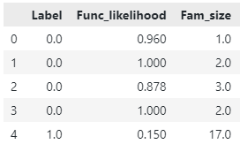
Step 6: Repeat step 2~5
6.1 Feature selection
Determining how important a feature is through permutation
Importance
proportional to
reduction in
model performance
Original model
“Permuted” model

Slide 27
Step 6: Repeat step 2~5
6.2 Retrain model using fewer features
QUESTION:
Why do we need to do this?

Slide 28
Step 7: Evaluate model
 |  | Truth
 |  | 0 | 1
Prediction | 0 | 100 | 0
 | 1 | 0 | 100
7.1 Apply the best model to the test set
By creating a confusion matrix
Then calculate evaluation metrics (e.g., ROC=AUC)
Training
data
Output:
ML
model
80%
Input:
all instances
all features
Training
Testing
data
Application
Model
Perform-
ance
20%

Slide 29
Step 7: Evaluate model
7.2 Confusion matrix
Q: Which one is better?
 |  | Truth
 |  | 0 | 1
Prediction | 0 | 100 | 0
 | 1 | 0 | 100
 |  | Truth
 |  | 0 | 1
Prediction | 0 | 55 | 45
 | 1 | 45 | 55

Slide 30
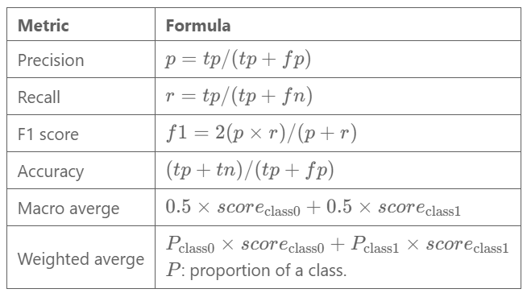
Step 7: Evaluate model
7.3 Classification report
Commonly used evaluation metrics

Slide 31
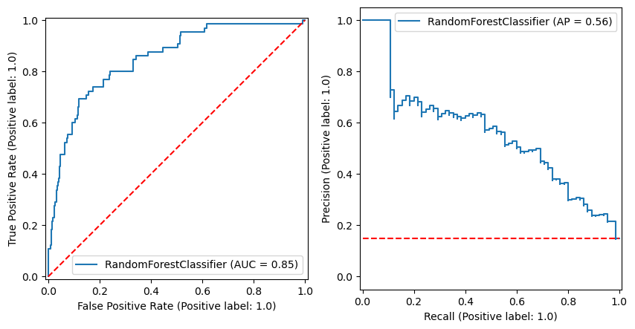
Step 7: Evaluate model
7.4 Graphics that help with evaluation

Slide 32
Step 8: Interpret model
But how and why does this work?
Why?
Global vs. local interpretation
Global
Explaining the relationship between
features and labels based on the entire model
Input: Experiences to learn from
Output:
A model making predictions
Local
Explaining the relationship between
features and labels based on 1 or few instances
Trouble-shooting
Novel insights
Trust
Azodi, Tang, Shiu (2020) Trends in Genetics

Slide 33
Recap: what we have done
Global & local
interpre-tation
ML workflow
Step 8:
Interpret
model
Step 4:
Engineer
features
Step 5:
Select
models
Step 1:
What is the question?
Step 3:
Split train/test
Answers
Good
enough?
Training
data
Training
Data
(engineered)
ML
model
Model
Performance
training
instances
80%
Step 2:
How does the data look like?
Data
Step 6: Repeat 2-5
No!
Testing
data
Model
Performance
testing
data
Yes!
20%
Step 9:
deploy
model
New data
Predictions
Step 7:
Evaluate
best performing
model

Slide 34

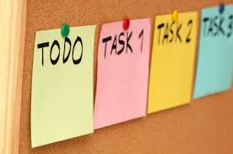
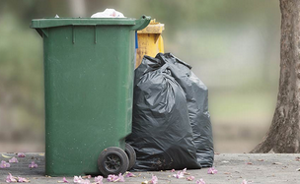

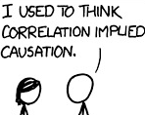

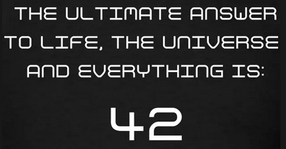

Recap: limitations of ML
Specific model need for each task
High quality & quantity of data
“Here we see that models, despite their reputation for impartiality, reflect goals and ideology…
Our own values and desires influence our choices, from the data we choose to collect to the questions we ask.
Models are opinions embedded in mathematics.”
Model tends not to be reusable
Supervised learning need labels
Instance | Label
Gene2 | SM
Gene1 | GM
…
Correlation NOT causation
Hidden variables
Model can be hard to
understand
Unknown bias in the data
Notes:
Image credit:
https://live.staticflickr.com/2615/4026814703_1e41b03876.jpg
https://upload.wikimedia.org/wikipedia/commons/a/af/Reduce_Reuse_Recycle.jpg
https://discover.rbcroyalbank.com/wp-content/uploads/banner-small-garbage-day_402x-1.jpg
http://intranetfactory.com/content2/image.axd?picture=2010%2F11%2Fistock_000011760242xsmall.jpg
https://image.spreadshirtmedia.com/image-server/v1/compositions/15153709/views/1,width=650,height=650,appearanceId=2,version=1547213188/hitchhikers-guide-42-t-shirt-all-our-hitchhikers-guide-products-are-unique-works-of-art-not-available-commercially-international-shipping-availabl.jpg
https://cdn.iconscout.com/icon/free/png-256/discount-ribbon-tag-label-sale-shop-shopping-1-24561.png
https://cdn.searchenginejournal.com/wp-content/uploads/2017/09/Untitled-design-10-760x400.png
https://www.vision.org/sites/default/files/img/2015fall_checking-the-bias_1920x1080.jpg

Slide 35
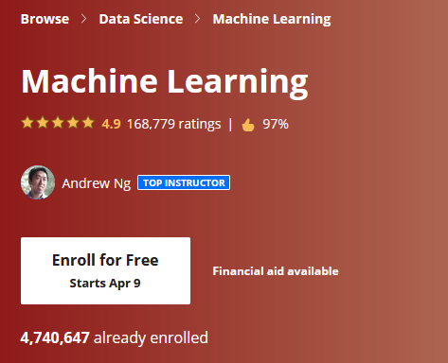

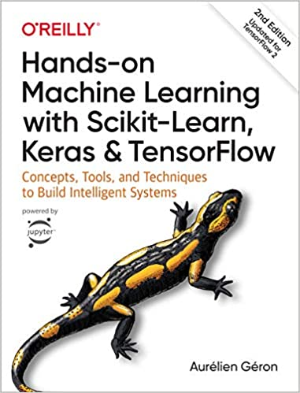
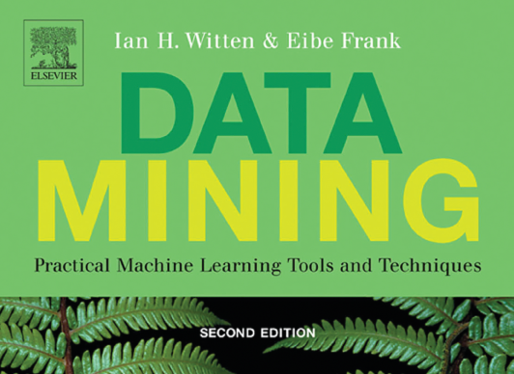

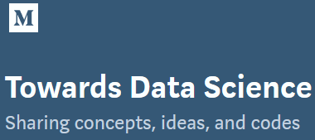
In your path forward
Start with:
Excellent books
Online courses
Blogs
Step 1:
What is the question?

Slide 36
Thanks for coming…
Please stay if you have any question

Slide 37
Spares

Slide 38

Logistics
Resource for today’s workshop:
Instruction
The pre-workshop Jupyter notebook
The workshop Jupyter notebook and dataset
This PowerPoint
https://github.com/ShiuLab/ML_workshop
Code of conduct - behaviors that will not be tolerated:
Any form of discrimination, e.g., based on gender, race, sexual orientation, age, or others.
Any form of harassment, e.g., sexual, verbal, bullying or others
Offensive language or behavior
Deliberate intimidation, sustained disruption.
All those online will be in one group.
Ask directly or use the chat function to raise questions

Slide 39
Step 4: Feature engineering
4.2 Data imbalance
When we separating labels and features…
Labels (y)
Features (X)

